Slide 1

WINDOWS OPERating system
Ivana RADovanović, SV 23/2022

Slide 2
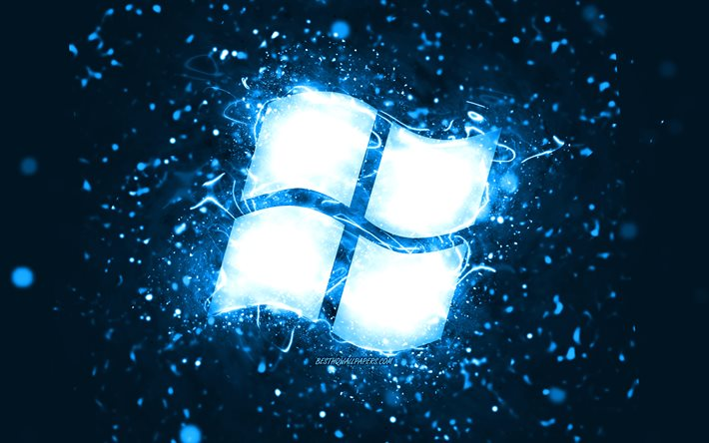
What are we going to talk about today?
WHAT IS WINDOWS?
BEGINNING OF WINDOWS OS
MOST POPULAR VERSIONS

Slide 3


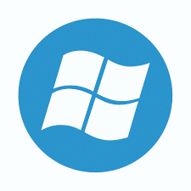
What is an operating system?
What is Windows?

Slide 4

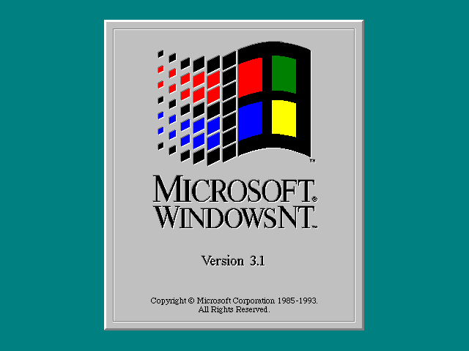
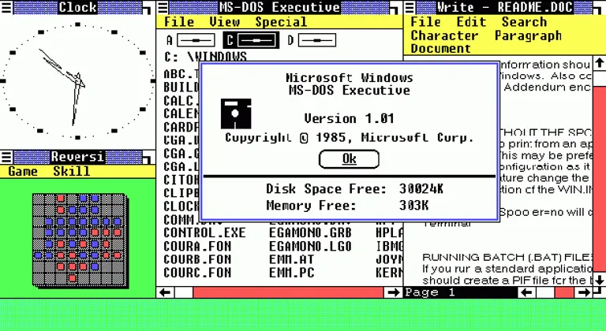
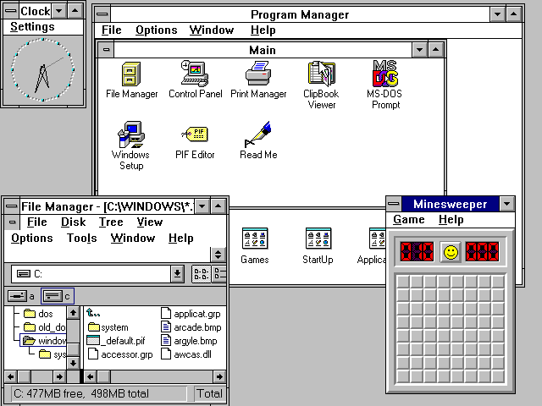
MICROSOFT WINDOWS THROUGH HISTORY
FIRST VERSION: Windows 1.0
RELEASE DATE: 20.11.1985.
MS-DOS family
PROGRAMMING LANGUAGE: BASIC
FIRST NT VERSION: Windows NT 3.1
RELEASE DATE: 27.7.1993.
NT family
PROGRAMMING LANGUAGE: C, Assembly language, C++, C#

Slide 5
Most popular versions of windows

Slide 6
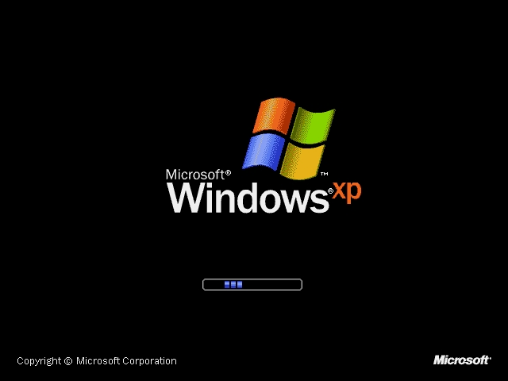
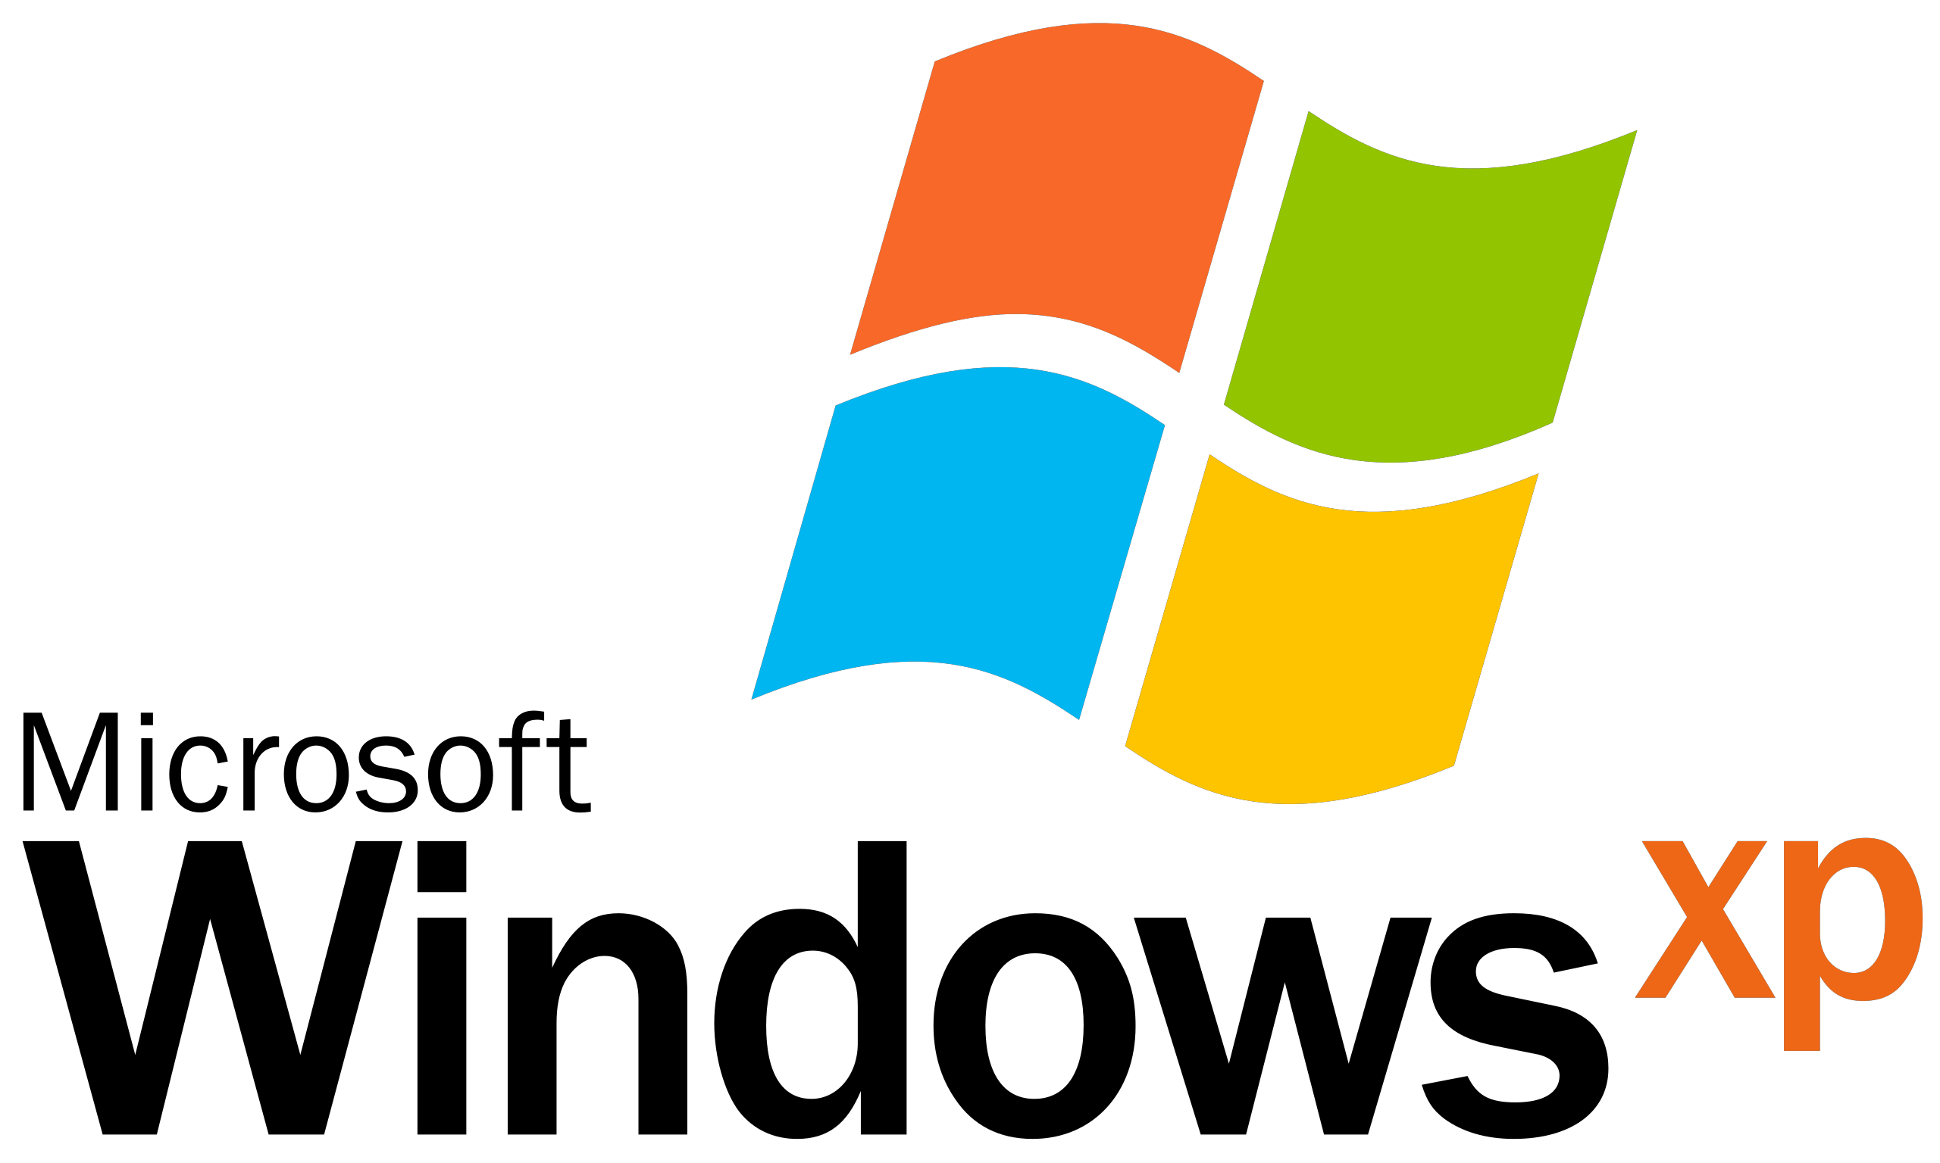
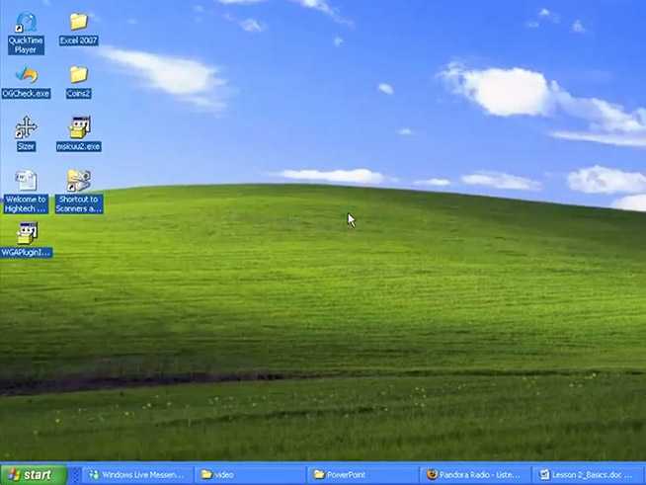
Microsoft windows xp
RELEASE DATE: 25.10.2001.
END OF SUPPORT: 8.4.2014.
120 000 000 units
Client NT
Second best operating system after Windows 7
UPDATES:
Redesigned, modern graphical user interface
More safety
Booting up time is faster
More programs available

Slide 7
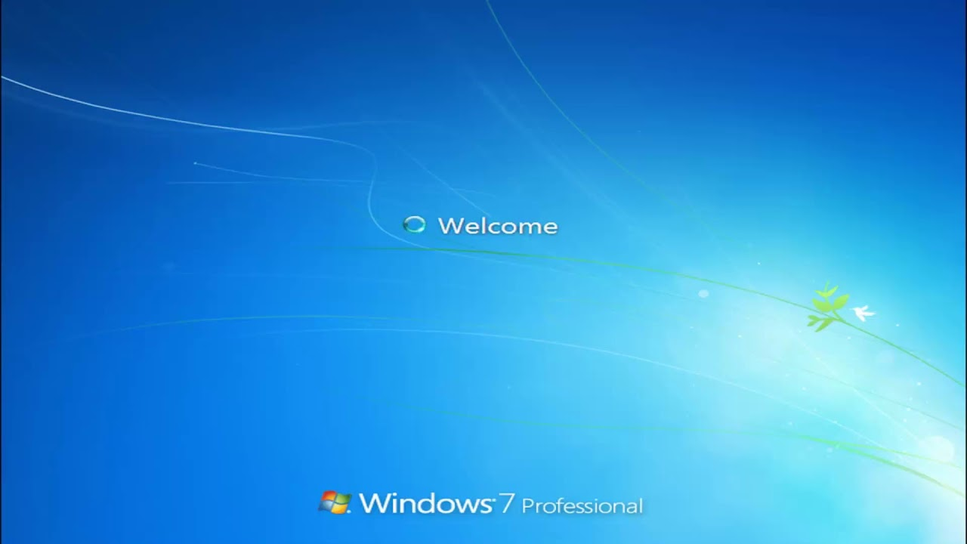
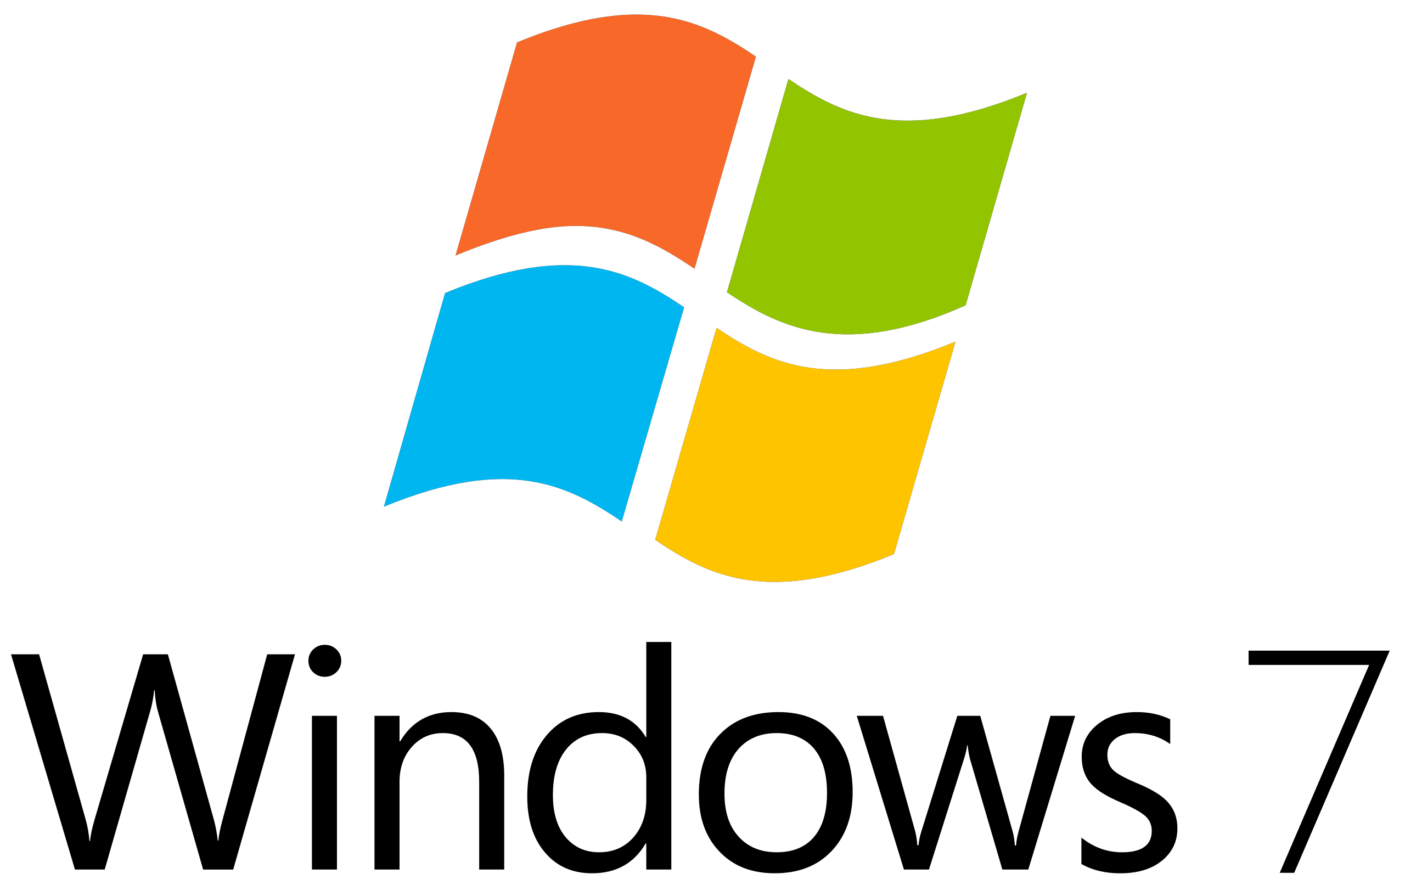
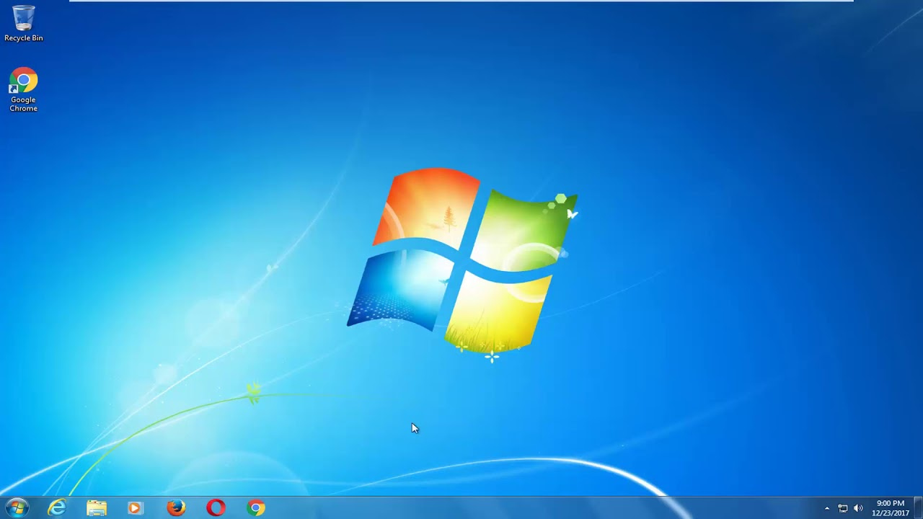
Microsoft windows 7
RELEASE DATE: 22.10.2009.
END OF SUPPORT: 14.1.2020.
450 000 000 units
Client NT
Microsoft’s best operating system
UPDATES:
More functions, like multi-touch support
New kind of taskbar
New options in the Control panel
More abilities for touch screen

Slide 8
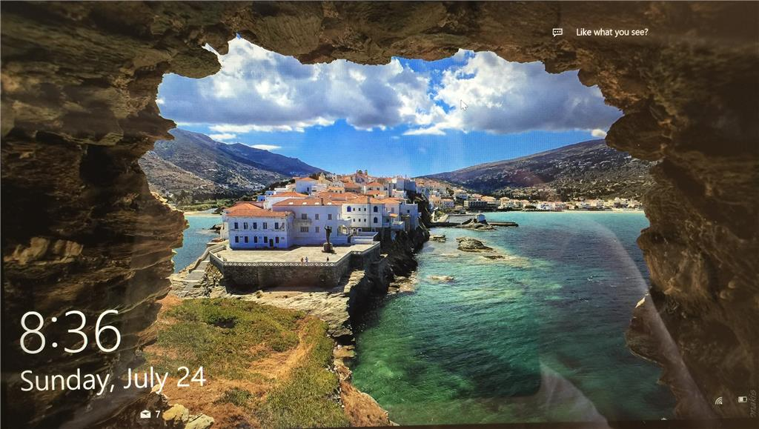
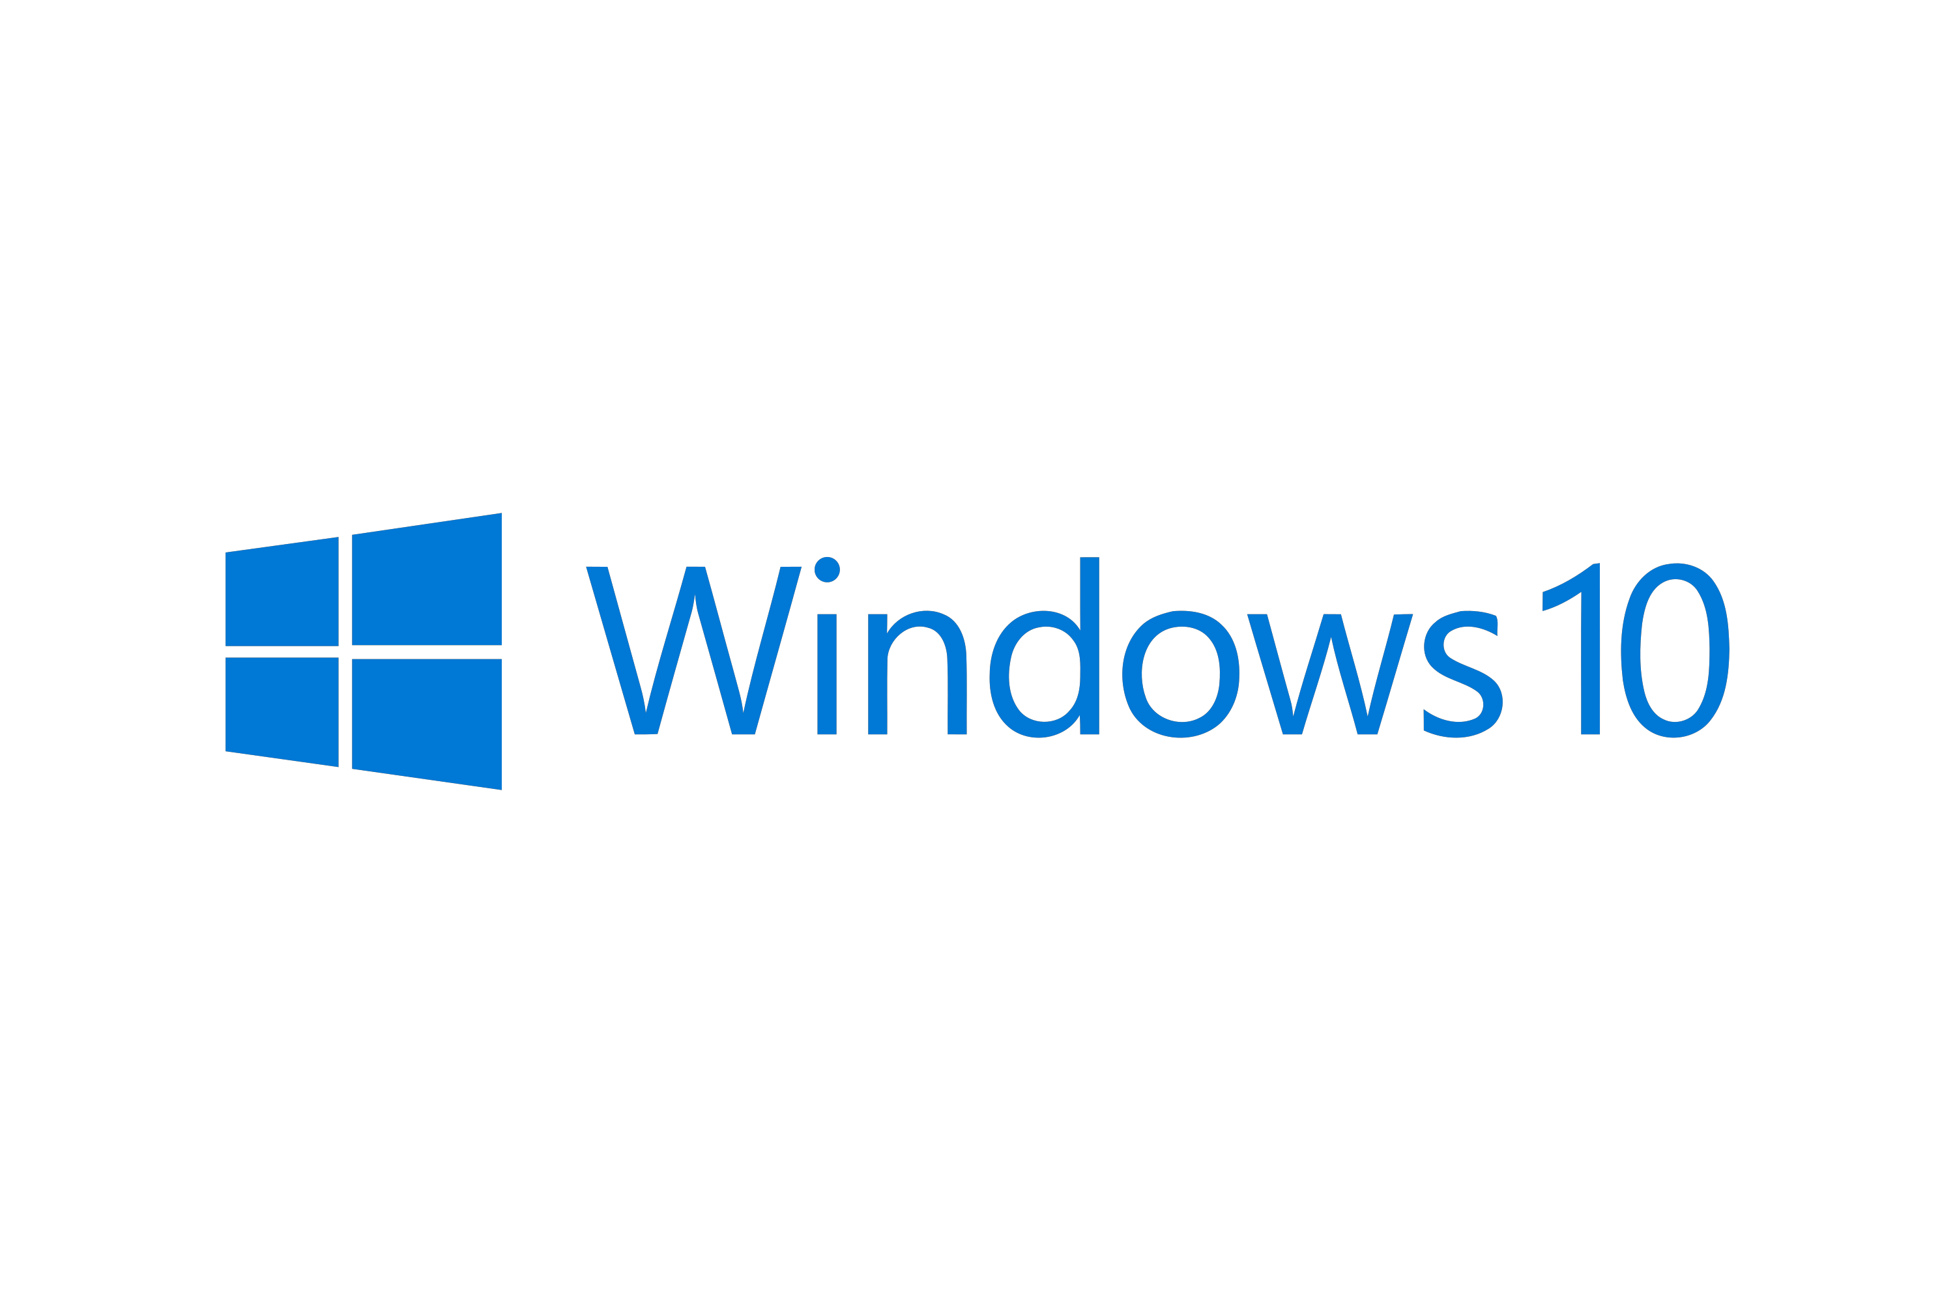
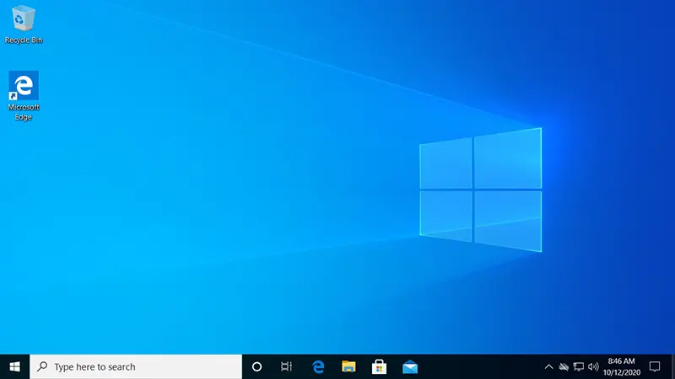
Microsoft windows 10
RELEASE DATE: 29.7.2015.
END OF SUPPORT: 9.1.2029.
400 000 000 units
Client NT
Microsoft Edge is released, a new standard broswer after 20 years of Internet Explorer
UPDATES:
New graphical user interface
New animations
New Start menu based on Windows 7 layout
More options in settings

Slide 9
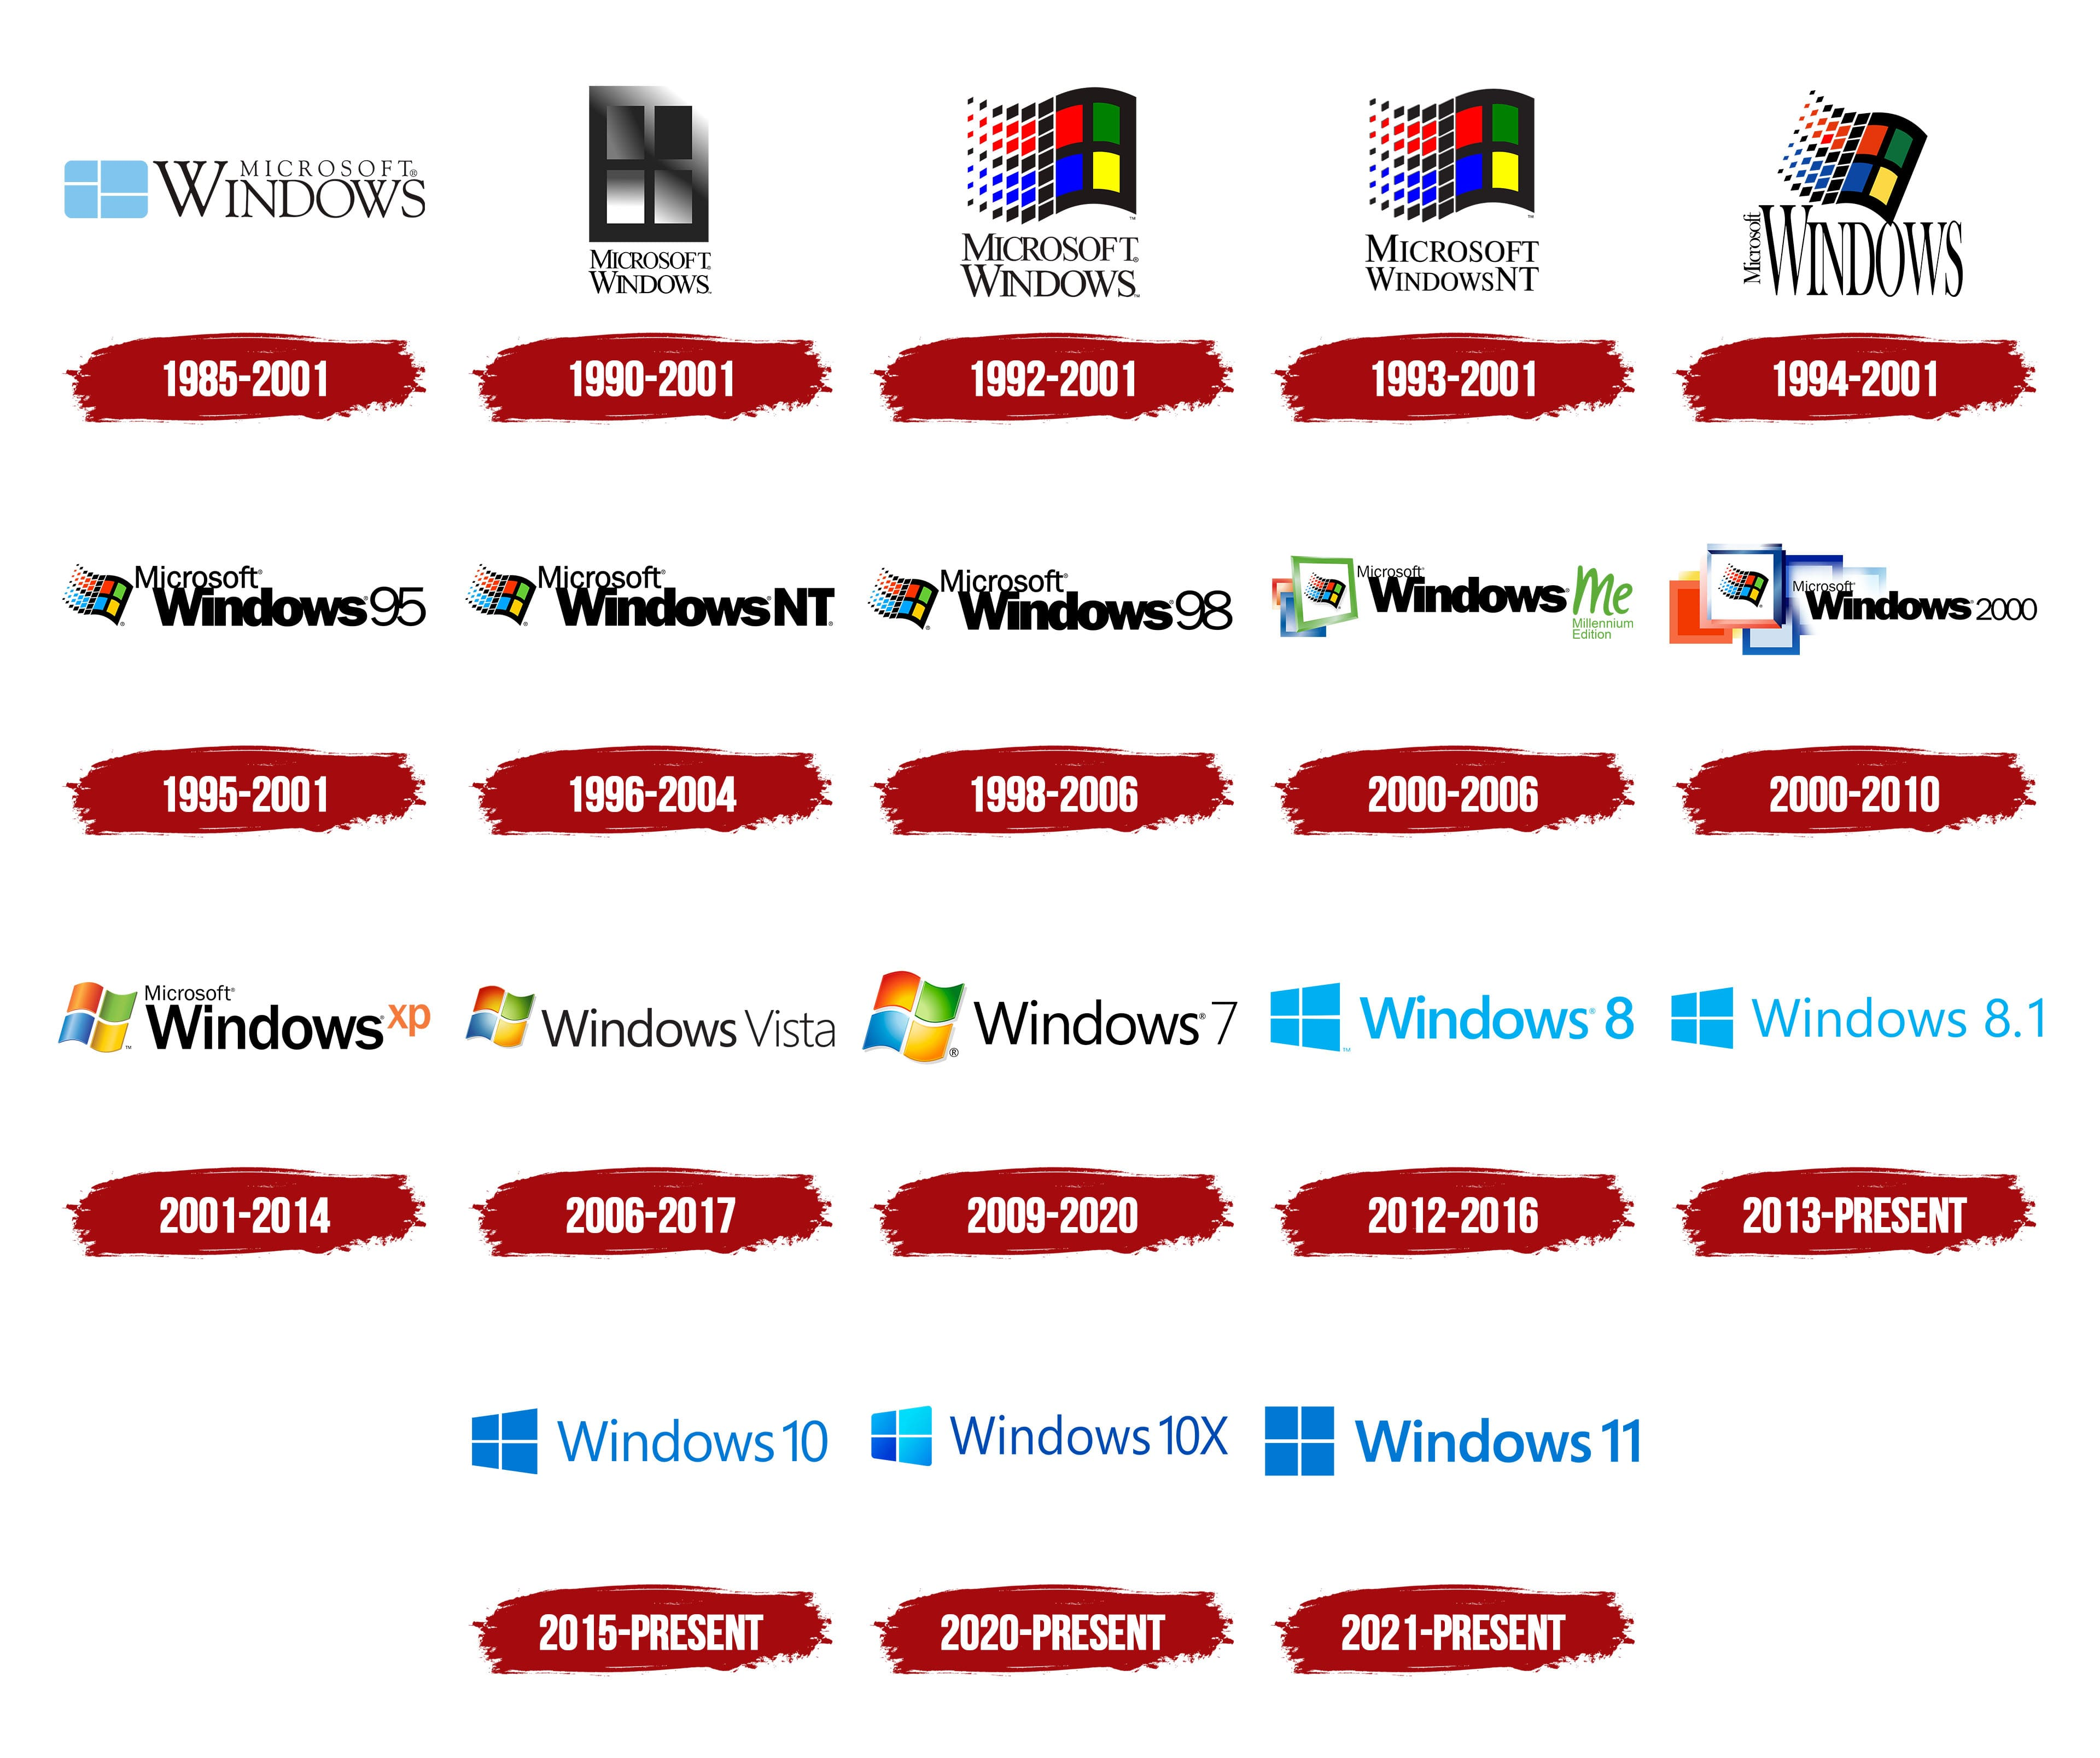

Slide 10
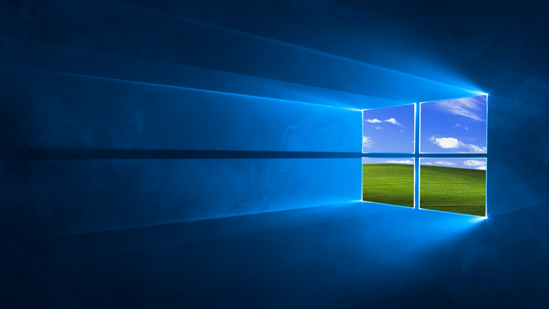
Thank You for your attention!
radovanovic.sv23.2022@uns.ac.rs
@svradovanovicivana

